Slide 1
JupyterHub ≠ x, ∀ x
What is JupyterHub really?
"Jupyter really is taking over the world" - Radovan Bast, CodeRefinery project manager

Slide 2
Outline
Contents
What is JupyterHub?
What role does it fill?
Examples of uses
My opinion on strategic usage
Themes
Jupyter isn't a service, but a way to access services
Jupyter can make computing more accessible
Jupyter is not perfect

Slide 3
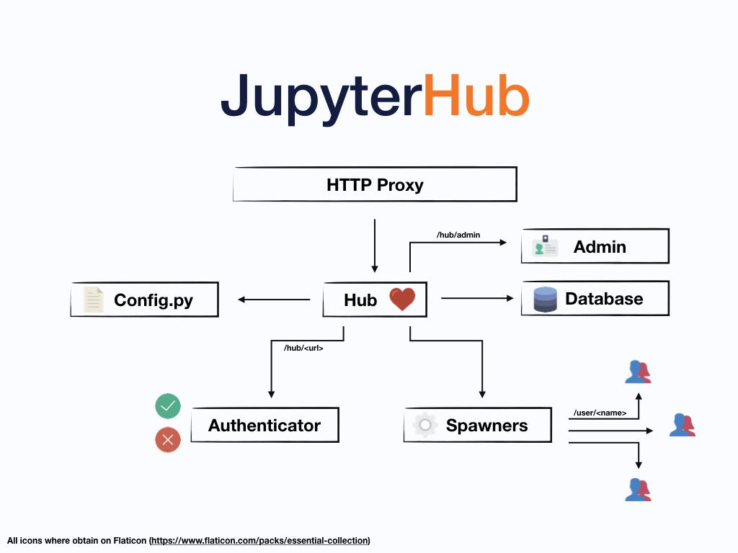
What is JupyterHub (formal definition)
Web frontend and gateway for Jupyter
Provides multi-user login
Resource management
Lightweight user management
JH is not the only way to provide Jupyter notebook access
https://jupyterhub.readthedocs.io/
"Official" schematic

Slide 4
Examples of typical Jupyter(Hub) deployments
Small group server access
Large MOOC courses - thousands of students
HPC clusters
SWAN - CERN data analysis environment - https://swan.web.cern.ch/
https://mybinder.org - create environment from git repo
Own computers
Deployments are as diverse as ssh server deployments.

Slide 5
The big question
Is Jupyter a "service"
or
is Jupyter a "interface to accessing resources"?
Example: "Let's just let CSC run jupyter, we don't need it too" to me sounds like "Let's let CSC run ssh, ...". Why have a cluster if it is hard to use?
Hint: I think it's the second

Slide 6
Service vs access method
JupyterHub is a service:
JupyterHub is a way of accessing services:
HPC
BioInf
JupHub
HPC
BioInf
JupHub
JupHub
ssh
ssh

Slide 7
Service vs access method
JupyterHub is a service:
JupyterHub is a way of accessing services:
HPC
BioInf
JupHub
HPC
BioInf
JupHub
JupHub
ssh
ssh

Slide 8
The big question
Is Jupyter a "service"
or
is Jupyter a "interface to accessing resources"?

Slide 9
The big question
Is Jupyter a "service"
or
is Jupyter a "interface to accessing resources"?
JupyterHub is a service:
JupyterHub is a way of accessing services:
HPC
BioInf
JupHub
HPC
BioInf
JupHub
JupHub
ssh
ssh

Slide 10
The big question
Is Jupyter a "service"
or
is Jupyter a "interface to accessing resources"?
Example: "Let's just let CSC run Jupyter, we don't need it too" to me sounds like "Let's let CSC run our ssh server, ...". Why have a cluster if it is hard to use?

Slide 11
Example: Aalto teaching JupyterHub
Primary use: courses
Typical teaching JH: one dedicated service per course
Aalto method:
One hub for light computing, with features added on for courses
Integrated to Aalto user accounts, Aalto data storage
Hub data is also mounted on some classroom workstations and mountable on any laptops
Benefits
Student data persists
Usable for other projects
Students have full control
Disadvantages
More complex setup
Students have full control
Can't do some "easy" things
Harder to explain

Slide 12
Typical teaching hub vs Aalto hub
Most hubs
Aalto hub
Course
User-first design
User data kept between courses
Users may use for purposes outside of courses
Users expected to learn skills to help them in life
(and complexity no greater than other courses)
User
Course
User
nbgrader
Storage
User
Course
Course
User
Computation
Storage
User
User
Shell
Computation
Editor
Shell
User entitlements by-course, student work lost after course (unless downloaded)
Editor
Version control
Version control

Slide 13
Example: Aalto research JupyterHub
Integrated to our HPC cluster
Same data, same accounts, same access to the Slurm scheduling system
Sama data also available by default on research workstations
JupyterHub is not another thing to learn, but an easier way to start using existing resources.

Slide 14
Light computing / scientific computing for all
How can we provide all the community with better computing (not jupyter) access?
end

